Slide 1
Jobs
IN
FOREIGN COUNTRIES

Slide 2
WWW.WORKAWAY.INFO
Why?
  To save money
  To get the best experience from foreign country
  To make friends from all over the world
  And 1000+ other reasons
How it works?
  Traveller + Host = ☺
  Host – someone who is seeking help (families, individuals, organizations, projects, …)
What can I get?
  Free food and accommodation
  Salary

Slide 3
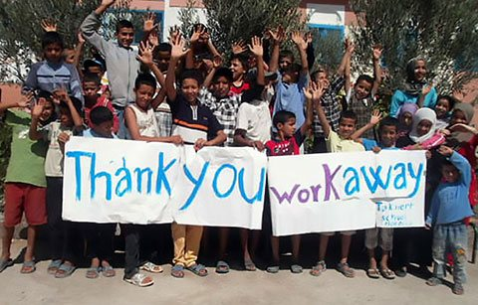
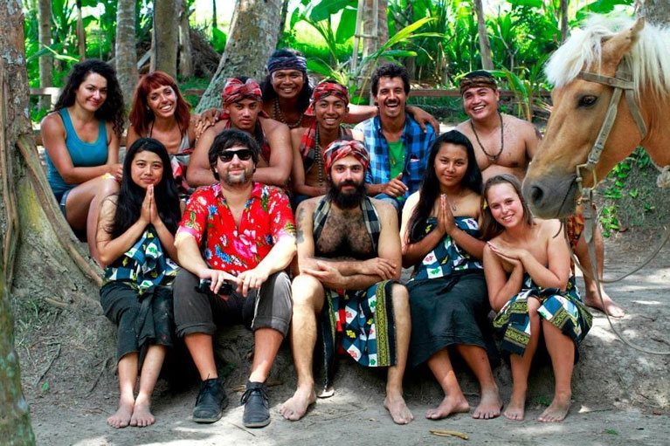
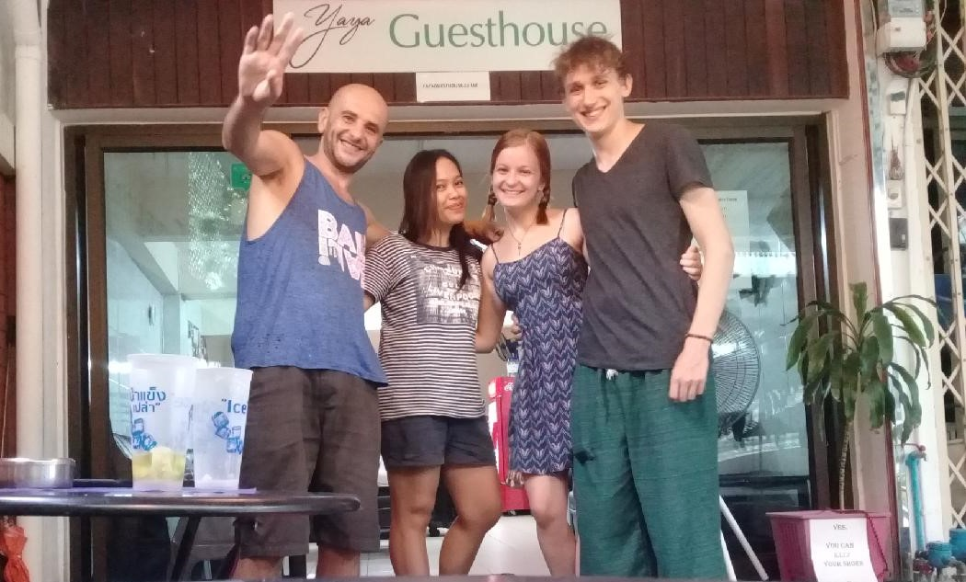
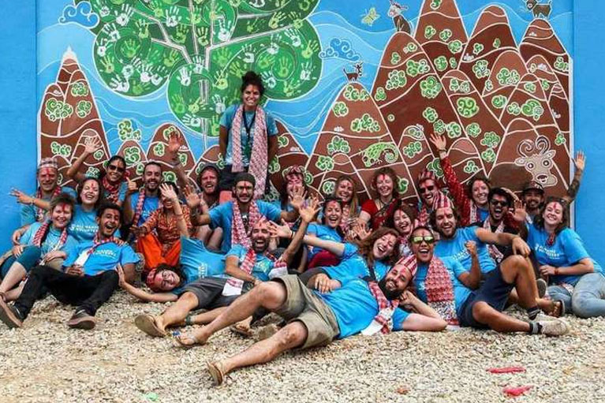
https://www.workaway.info/

